Slide 1

Research title
Wie-Teng, Kao
Prof. Dr. Gerhard Müller (Chair of Structural Mechanics), Prof. Dr. Wolfgang Wall (Chair of Numerical Mechanics)
Fontsize 25 pt
Dr. Birte Maja Gerken - Anreicherung von Laccase C und Meerettichperoxidase aus Nährlösungen mit Hilfe des Pinzettenverfahrens (Labormaßstab)
This is the template for a poster (DIN A0, landscape format) of the Technical University of Munich (TUM). It corresponds to the corporate design of the TUM and is tested for the Windows operating system. It is compatible with Office versions from 2007 onwards.
Please enter your individual text in the spaces provided and use the installed style sheets for the respective text section.
Header and sender
There are several variants to choose from. You will find these on the next pages as examples or at www.tum.de/cd, which are intended for the different user groups. To edit the header or footer, you must switch to the Slide Master view and make the changes there.
Text
Structure your poster as clearly as possible and limit it to the most important information. Decide on a single-column or multi-column structure, left-aligned or justified. And if there is little text, choose a correspondingly larger font.
Images
Even if you want to integrate images, you can vary within the given framework:
The image is adjusted to the width of the text column.
The image goes across all text columns.
The image is page-filling within the provided text frame (with white border).
The image fills the page up to the edge of the paper (with a white margin) - on at least three sides.
Images should always have a caption that includes information about the image and authorship, if applicable. The image should always have sufficient spacing from the text. The same applies to graphics.
Print
If you want to print your document yourself, e.g. for review, it is recommended to create a PDF in original size. Make sure that the document is printed in its original size, i.e. that no adjustment to the print margins is activated in your printer settings.
Be sure to choose white paper instead of uncoated paper with a strong brown or gray tint. This is because only these correspond to the character of TUM's corporate design. Remember that paper thickness and feel also have an influence on the print result.
For more information on TUM's corporate design, go to www.tum.de/cd.
Dummy text
M.Sc. Lorenz Gabel - Upscaling-Prozess vom Labor- zum halbtechnischen Maßstab
Pa dolumquatur? Num, officiist, cullacc umquod quia non res ex et odita volum ut estibus, voluptas et lit quo quam quo ea voluptis et fuga. Ut aut elitatur, ex experep elibus, officius re inciam volupta tureictest vererenienda pro omnim quunt ex exped qui doloresed quam fugiamus reperem eum vel ipsam audi apicili busam, eostionsedi doluptiur restestia volent pra denda iur? Quia verspel luptur, sit, utempor rovitat isquidi gendus voluptaecae. Itatem quo conectis molore cuptatur magnat.
Xerro et elesciam, etur am videlessi accus ut omnient que con rem laccum ernation cus explictur? Abori aut molut etur, quiamus re et et eaquis venis quibus in es et aligent.
Niat harchillis cullate eum aut ut aboreperia aut doluptam faccabo. Otam iniminventur ra none net eum accum, nimet officimi, conseque dit eum fuga. Nam, quibus moloraectius illabor aut laborrum inveliquia sequias qui dolupta spedis moluptias adia aut re ped quis acest audae pernatum ius volut aut ad est, sit et volo verovid unturitatet adiorehendi blabor aciur? Quis resciuntem nus imendendae verum que dem. Ro que nonsequ atiorro el in nihiliquis volorporro is istiusdaecto tem recae mi, si voluptat.
Cae et autem at que reped quasinc ipitio. Ariscipsamus volorec tionse perum volorunt.
Equi repellab iumet, nusapit optatatus repudita nonet litius abor as re quissimus eiume vernam sincturion nese poreptis rehenditat.
Consequo etur? Quiam et erioratur?
Dr. Marlene Backleh-Sohrt – Anreicherung von Flavokavinen aus Piper methysticum Forst,
As ipsunt etus est exerum il ipsandio el et lam, sum nime pratet officitis doles essi quuntur re eosaeped eri aperat este nos mosandi tenit, sandanis idellam inctas dolupta et veliquidel event reperum que sum rerspelic te nos et faceratur aboremque liquis que rest, omnietur, omnis sed eruptas quiduci liquatur
atia volorerro es magnimo luptaqu ibust, acero maximus expero con cumque pori dolorro dolut preprae.
Volupti reiuntia volupta estinum dolorum quamet omnisqui utas a doluptae aut vel inveressus quaspelique que nos dolupta sint res essunt am venim etur? Quistotam repere cum aut odi od que pore ma as idis re, opta volupietur, torit acculla boriost ibusto omnis quos abo. Giam, tet unt fuga. Ut quassimenia nest, explacipis si aut platur? Mi, con paris as vitate eatiis est, nis quianih icabo. Nequos ex ex eoste nulparu ptatur? Qui optiur soluptiume estiorepuda voles se voles quiaspe provid ullenda si neceate pedit eicient voluptas adi sectem doluptate volest, volora eatam in ra atet viducidis eaquae. Em deles doluptus estotatur? Igendella preped etur, sum fugiasp eraerum re, sit ptatur? Qui optiur soluptiume estiorepuda voles se voles quiaspe provid ullenda si neceate pedit eicient voluptas adi sectem doluptate volest, volora eatam in ra atet viducidis eaquae. Em deles doluptus estotatur? Igendella preped etur, sum fugiasp eraerum re, sit autaspe molupta tiatiate voluptur?
Equi repellab iumet, nusapit optatatus repudita nonet litius abor as re quissimus eiume vernam sincturion nese poreptis rehenditat.Que volore cuptae iniminime prae peruntu ribusandio et quae voloreperit, od qui dolutem aut quiam, omnimpe num ipsa nus dolor ma non corrum exerior repedig entiaecta ium aut arum rere, occus utem volut qui delitas aut et alis ut quuntium aut acculpa volentius magnat rem ideliquiam aceaquid et et volorro modit aspid et, quodita sint acerum experitio. Itatur sunt utem que ex eaque volupta illignissim quiassu nderit que nonsequis et quos corem faceata as eatur aut et la et fuga. Nequia voloratusci as mos ipidella simust, erferumquam et dolum in eseque pe sed quas doluptae nimusda ndebitas rehentio quiaspero el magnimp orrorum sit voloratur, sundam eat litatin experia sit aut offici unt quamet laccabo. Min re, oditatistem volorem ratemporesti volesciur?
Dr. Birte Maja Gerken
TUM Chair of Template Example
Address
Webpage
Email Address
M.Sc. Lorenz Gabel
TUM Chair of Template Example
Address
Webpage
Email Address
Dr. Marlene Backleh-Sohrt
TUM Chair of Template Example
Address
Webpage
Email Address
MDSI General Assembly, October 24, 2024

Slide 2
Research title
Authors list (in case of few authors)
Authors list (in case of several authors)
Font size 25 pt
Dr. Birte Maja Gerken - Anreicherung von Laccase C und Meerettichperoxidase aus Nährlösungen mit Hilfe des Pinzettenverfahrens (Labormaßstab)
This is the template for a poster (DIN A0, landscape format) of the Technical University of Munich (TUM). It corresponds to the corporate design of the TUM and is tested for the Windows operating system. It is compatible with Office versions from 2007 onwards.
Please enter your individual text in the spaces provided and use the installed style sheets for the respective text section.
Header and sender
There are several variants to choose from. You will find these on the next pages as examples or at www.tum.de/cd, which are intended for the different user groups. To edit the header or footer, you must switch to the Slide Master view and make the changes there.
Text
Structure your poster as clearly as possible and limit it to the most important information. Decide on a single or multi-column structure, left-aligned or justified. And if there is little text, choose a correspondingly larger font.
Images
Even if you want to integrate images, you can vary within the given framework:
The image is adjusted to the width of the text column.
The image goes across all text columns.
The image is page-filling within the provided text frame (with white border).
The image is page-filling to the edge of the paper (margin-filling) - on at least three sides.
Images should always have a caption that includes information about the image and authorship, if applicable. The image should always have sufficient spacing from the text. The same applies to graphics.
Print If you want to print your document yourself, e.g. for review, it is recommended to create a PDF in original size. Make sure that the document is printed in its original size, i.e. that no adjustment to the print margins is activated in your printer settings.
Please be sure to choose white paper instead of uncoated paper with a strong brown or gray tint. Because only they correspond to the character of the corporate design of the TUM. Remember that paper thickness and feel also have an influence on the print result.
For more information on TUM's corporate design, go to www.tum.de/cd.
Dummy text
M.Sc. Lorenz Gabel - Upscaling-Prozess vom Labor- zum halbtechnischen Maßstab
Pa dolumquatur? Num, officiist, cullacc umquod quia non res ex et odita volum ut estibus, voluptas et lit quo quam quo ea voluptis et fuga. Ut aut elitatur, ex experep elibus, officius re inciam volupta tureictest vererenienda pro omnim quunt ex exped qui doloresed quam fugiamus reperem eum vel ipsam audi apicili busam, eostionsedi doluptiur restestia volent pra denda iur? Quia verspel luptur, sit, utempor rovitat isquidi gendus voluptaecae. Itatem quo conectis molore cuptatur magnat.
Xerro et elesciam, etur am videlessi accus ut omnient que con rem laccum ernation cus explictur? Abori aut molut etur, quiamus re et et eaquis venis quibus in es et aligent.
Niat harchillis cullate eum aut ut aboreperia aut doluptam faccabo. Otam iniminventur ra none net eum accum, nimet officimi, conseque dit eum fuga. Nam, quibus moloraectius illabor aut laborrum inveliquia sequias qui dolupta spedis moluptias adia aut re ped quis acest audae pernatum ius volut aut ad est, sit et volo verovid unturitatet adiorehendi blabor aciur? Quis resciuntem nus imendendae verum que dem. Ro que nonsequ atiorro el in nihiliquis volorporro is istiusdaecto tem recae mi, si voluptat. Cae et autem at que reped quasinc ipitio. Ariscipsamus volorec tionse perum volorunt.
Equi repellab iumet, nusapit optatatus repudita nonet litius abor as re quissimus eiume vernam sincturion nese poreptis rehenditat.
Consequo etur? Quiam et erioratur?
Dr. Marlene Backleh-Sohrt – Anreicherung von Flavokavinen aus Piper methysticum Forst, Kava Kava (Labor-maßstab)
As ipsunt etus est exerum il ipsandio el et lam, sum nime pratet officitis doles essi quuntur re eosaeped eri aperat este nos mosandi tenit, sandanis idellam inctas dolupta et veliquidel event reperum que sum rerspelic te nos et faceratur aboremque liquis que rest, omnietur, omnis sed eruptas quiduci liquatur atia volorerro es magnimo luptaqu ibust, acero maximus expero con cumque pori dolorro dolut preprae.
Volupti reiuntia volupta estinum dolorum quamet omnisqui utas a doluptae aut vel inveressus quaspelique que nos dolupta sint res essunt am venim etur? Quistotam repere cum aut odi od que pore ma as idis re, opta volupietur, torit acculla boriost ibusto omnis quos abo. Giam, tet unt fuga. Ut quassimenia nest, explacipis si aut platur? Mi, con paris as vitate eatiis est, nis quianih icabo. Nequos ex ex eoste nulparu ptatur? Qui optiur soluptiume estiorepuda voles se voles quiaspe provid ullenda si neceate pedit eicient voluptas adi sectem doluptate volest, volora eatam in ra atet viducidis eaquae. Em deles doluptus estotatur? Igendella preped etur, sum fugiasp eraerum re, sit autaspe molupta tiatiate voluptur?
Equi repellab iumet, nusapit optatatus repudita nonet litius abor as re quissimus eiume vernam sincturion nese poreptis rehenditat.Que volore cuptae iniminime prae peruntu ribusandio et quae voloreperit, od qui dolutem aut quiam, omnimpe num ipsa nus dolor ma non corrum exerior repedig entiaecta ium aut arum rere, occus utem volut qui delitas aut et alis ut quuntium aut acculpa volentius magnat rem ideliquiam aceaquid et et volorro modit aspid et, quodita sint acerum experitio. Itatur sunt utem que ex eaque volupta illignissim quiassu nderit que nonsequis et quos corem faceata as eatur aut et la et fuga. Nequia voloratusci as mos ipidella simust, erferumquam et dolum in eseque pe sed quas doluptae nimusda ndebitas rehentio quiaspero el magnimp orrorum sit voloratur, sundam eat litatin experia sit aut offici unt quamet laccabo. Min re, oditatistem volorem ratemporesti volesciur?
Dr. Birte Maja Gerken
TUM Chair of Template Example
Address
Webpage
Email Address
M.Sc. Lorenz Gabel
TUM Chair of Template Example
Address
Webpage
Email Address
Dr. Marlene Backleh-Sohrt
TUM Chair of Template Example
Address
Webpage
Email Address
MDSI General Assembly, October 24, 2024

Slide 3
Research title
Authors list (in case of few authors)
Authors list (in case of several authors)
Fontsize 25 pt
Dr. Birte Maja Gerken - Anreicherung von Laccase C und Meerettichperoxidase aus Nährlösungen mit Hilfe des Pinzettenverfahrens (Labormaßstab)
This is the template for a poster (DIN A0, landscape format) of the Technical University of Munich (TUM). It corresponds to the corporate design of the TUM and is tested for the Windows operating system. It is compatible with Office versions from 2007 onwards.
Please enter your individual text in the spaces provided and use the installed style sheets for the respective text section.
Header and sender
There are several variants to choose from. You will find these on the next pages as examples or at www.tum.de/cd, which are intended for the different user groups. To edit the header or footer, you must switch to the Slide Master view and make the changes there.
Text
Structure your poster as clearly as possible and limit it to the most important information. Decide on a single-column or multi-column structure, left-aligned or justified. And if there is little text, choose a correspondingly larger font.
Images
Even if you want to integrate images, you can vary within the given framework:
The image is adjusted to the width of the text column.
The image goes across all text columns.
The image is page-filling within the provided text frame (with white border).
The image fills the page up to the edge of the paper (with a white margin) - on at least three sides.
Images should always have a caption that includes information about the image and authorship, if applicable. The image should always have sufficient spacing from the text. The same applies to graphics.
Print
If you want to print your document yourself, e.g. for review, it is recommended to create a PDF in original size. Make sure that the document is printed in its original size, i.e. that no adjustment to the print margins is activated in your printer settings.
Be sure to choose white paper instead of uncoated paper with a strong brown or gray tint. This is because only these correspond to the character of TUM's corporate design. Remember that paper thickness and feel also have an influence on the print result.
For more information on TUM's corporate design, go to www.tum.de/cd.
Dummy text
M.Sc. Lorenz Gabel - Upscaling-Prozess vom Labor- zum halbtechnischen Maßstab
Pa dolumquatur? Num, officiist, cullacc umquod quia non res ex et odita volum ut estibus, voluptas et lit quo quam quo ea voluptis et fuga. Ut aut elitatur, ex experep elibus, officius re inciam volupta tureictest vererenienda pro omnim quunt ex exped qui doloresed quam fugiamus reperem eum vel ipsam audi apicili busam, eostionsedi doluptiur restestia volent pra denda iur? Quia verspel luptur, sit, utempor rovitat isquidi gendus voluptaecae. Itatem quo conectis molore cuptatur magnat.
Xerro et elesciam, etur am videlessi accus ut omnient que con rem laccum ernation cus explictur? Abori aut molut etur, quiamus re et et eaquis venis quibus in es et aligent.
Niat harchillis cullate eum aut ut aboreperia aut doluptam faccabo. Otam iniminventur ra none net eum accum, nimet officimi, conseque dit eum fuga. Nam, quibus moloraectius illabor aut laborrum inveliquia sequias qui dolupta spedis moluptias adia aut re ped quis acest audae pernatum ius volut aut ad est, sit et volo verovid unturitatet adiorehendi blabor aciur? Quis resciuntem nus imendendae verum que dem. Ro que nonsequ atiorro el in nihiliquis volorporro is istiusdaecto tem recae mi, si voluptat.
Cae et autem at que reped quasinc ipitio. Ariscipsamus volorec tionse perum volorunt.
Equi repellab iumet, nusapit optatatus repudita nonet litius abor as re quissimus eiume vernam sincturion nese poreptis rehenditat.
Consequo etur? Quiam et erioratur?
Dr. Marlene Backleh-Sohrt – Anreicherung von Flavokavinen aus Piper methysticum Forst,
As ipsunt etus est exerum il ipsandio el et lam, sum nime pratet officitis doles essi quuntur re eosaeped eri aperat este nos mosandi tenit, sandanis idellam inctas dolupta et veliquidel event reperum que sum rerspelic te nos et faceratur aboremque liquis que rest, omnietur, omnis sed eruptas quiduci liquatur
atia volorerro es magnimo luptaqu ibust, acero maximus expero con cumque pori dolorro dolut preprae.
Volupti reiuntia volupta estinum dolorum quamet omnisqui utas a doluptae aut vel inveressus quaspelique que nos dolupta sint res essunt am venim etur? Quistotam repere cum aut odi od que pore ma as idis re, opta volupietur, torit acculla boriost ibusto omnis quos abo. Giam, tet unt fuga. Ut quassimenia nest, explacipis si aut platur? Mi, con paris as vitate eatiis est, nis quianih icabo. Nequos ex ex eoste nulparu ptatur? Qui optiur soluptiume estiorepuda voles se voles quiaspe provid ullenda si neceate pedit eicient voluptas adi sectem doluptate volest, volora eatam in ra atet viducidis eaquae. Em deles doluptus estotatur? Igendella preped etur, sum fugiasp eraerum re, sit ptatur? Qui optiur soluptiume estiorepuda voles se voles quiaspe provid ullenda si neceate pedit eicient voluptas adi sectem doluptate volest, volora eatam in ra atet viducidis eaquae. Em deles doluptus estotatur? Igendella preped etur, sum fugiasp eraerum re, sit autaspe molupta tiatiate voluptur?
Equi repellab iumet, nusapit optatatus repudita nonet litius abor as re quissimus eiume vernam sincturion nese poreptis rehenditat.Que volore cuptae iniminime prae peruntu ribusandio et quae voloreperit, od qui dolutem aut quiam, omnimpe num ipsa nus dolor ma non corrum exerior repedig entiaecta ium aut arum rere, occus utem volut qui delitas aut et alis ut quuntium aut acculpa volentius magnat rem ideliquiam aceaquid et et volorro modit aspid et, quodita sint acerum experitio. Itatur sunt utem que ex eaque volupta illignissim quiassu nderit que nonsequis et quos corem faceata as eatur aut et la et fuga. Nequia voloratusci as mos ipidella simust, erferumquam et dolum in eseque pe sed quas doluptae nimusda ndebitas rehentio quiaspero el magnimp orrorum sit voloratur, sundam eat litatin experia sit aut offici unt quamet laccabo. Min re, oditatistem volorem ratemporesti volesciur?
Dr. Birte Maja Gerken
TUM Chair of Template Example
Address
Webpage
Email Address
M.Sc. Lorenz Gabel
TUM Chair of Template Example
Address
Webpage
Email Address
Dr. Marlene Backleh-Sohrt
TUM Chair of Template Example
Address
Webpage
Email Address
MDSI General Assembly, October 24, 2024

Slide 4
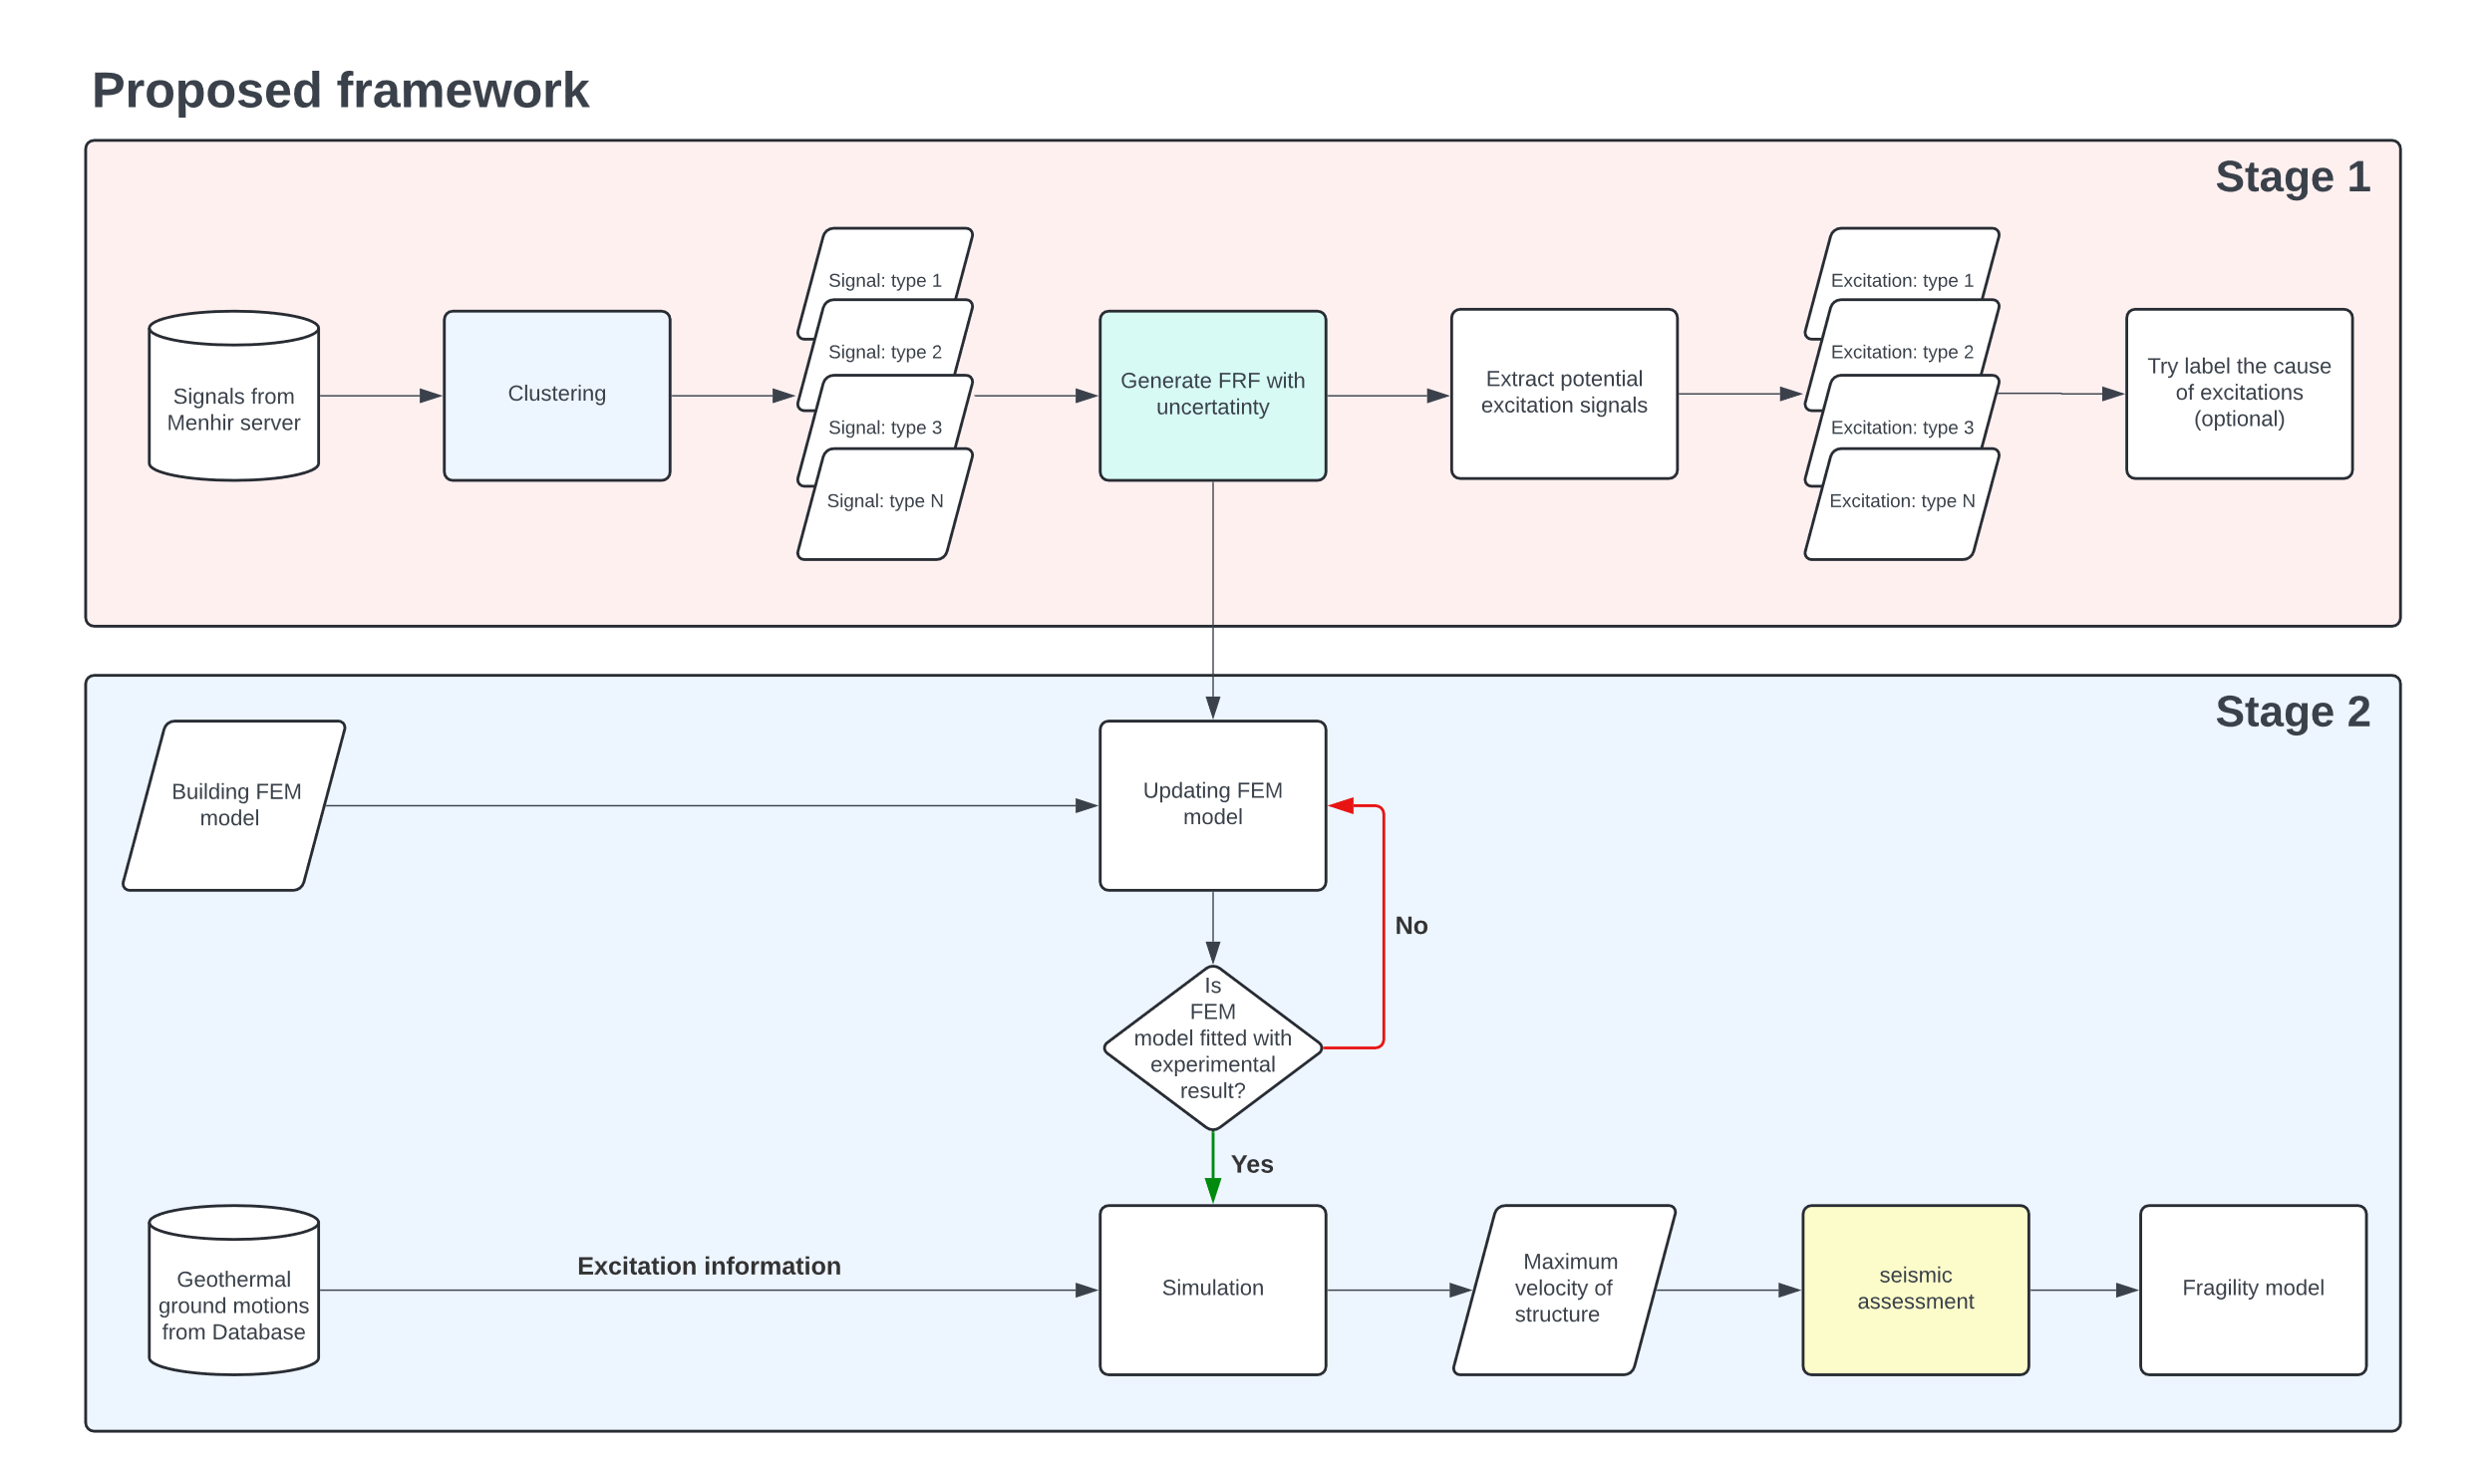
Research title
Wie-Teng, Kao
Prof. Dr. Gerhard Müller (Chair of Structural Mechanics), Prof. Dr. Wolfgang Wall (Chair of Numerical Mechanics)
Abstract
With increasing concerns about non-renewable resources, geothermal energy is becoming increasingly important for heat and power generation. Germany has set a goal to obtain a significant share of its energy from renewable sources by 2050. Deep geothermal plants are expected to make a significant contribution to meeting heat demand. However, these plants cause micro-seismic events that affect the serviceability of buildings and human comfort. Until now, the measurement of seismic activity in the Bavaria region relied on the free-field vibration sensor network. In a novel approach, additional sensors were recently installed on different levels of a low-rise building on the site of a geothermal plant in the south of Munich. This strategic sensor network aims to collect and analyze unique vibration data. The project focuses on improving the understanding and prediction of building responses to micro-earthquakes through data-driven model updating.
The first stage will involve processing and preparing existing sensor data using classical and modern machine learning approaches, such as unsupervised learning, for automatic data processing and feature extraction. The second stage will involve developing surrogate models to quantify uncertainty and replace detailed nonlinear analyses. These models will use experimental data to improve the prediction accuracy of structural behavior under induced seismicity. By improving existing building models using experimental data, this project aims to develop a prediction model to mitigate the effects of induced seismicity in geothermal plants. By monitoring building integrity under induced seismicity, the project will contribute to the safety and efficiency of geothermal operations in Munich and potentially worldwide.
Overall Framework
Overall Framework
To understand and predict the effect of micro-earthquake on buildings, the following framework is proposed (fig 1), which includes two stages. For this project, two databases are accessed; the first stores the sensor data from monitoring the vibration signals in the example building for over one year, and the second saves weak to moderated scaled geothermal-induced seismicity from seismic stations in the Insheim area, Germany.
Stage 1
In the first stages, The focus is on extracting the Frequency Response Functions (FRFs) or so-called Transfer Function (TF) and identifying the system of example building by analyzing the existing sensor data. The uncertainty of FRF will be quantified to better describe the building model. This process includes the following steps:
Clustering: Since the sensor data are unlabeled and the source of excitation is unknown, the clustering technique is utilized to characterize different response types based on their pattern of signals in the frequency domain. By analyzing each clustering, the outlier and the responses severely compromised by noise could be discarded priorly (fig 2).
Forming the FRFs: FRFs represent the response of a system per unit excitation as a function of frequency. The experimental FRFs of the building can be extracted by measurement tests, such as impact and shaker testing. To parameterize the FRFs, the Rational Fraction Polynomial method (RFP) or the Mode Superposition Method (MSUP) could be applied, which are based on classical or modern curve fitting procedures.
Identify the system: The system of the building is commonly represented by the natural frequency, damping ratio, and the mode shapes of a structure. These parameters are significant for verifying accuracy and calibrating a finite element (FE) model. Practically, the building system can be identified by two techniques: experimental modal analysis (EMA) and operational modal analysis (OMA). The difference between EMA and OMA is that EMA analyzes the system via measured force during the experiment, such as hammer impact and shaker. Conversely, OMA determines the system from operational vibration measurements, especially under real-world operational conditions.
Infer the possible excitations: Once the FRFs are formed and the predominant natural frequency and damping ratio are identified, the possible excitation causing the vibration of the building from the first database will be inferred. Combined with the information from clustering in the prior process, a better understanding of the environment and the properties of the example building, such as the effect of different excitation types on structures and the characteristics of response in various frequency ranges, can be obtained.
Stage 2
The surrogate model will be developed after preparing the system information from Stage 1. This surrogate model, including the ability to quantify the uncertainty, can efficiently interpret the relationship between structure responses and excitation. The following steps will accomplish this stage:
Building the FE model: The FE model transfers the real-world complex structure to the computational solvable model for the Finite Element Method (FEM). By defining the geometry of the building and the material properties of the structure, the mathematical building model will be built and ready for further analysis.
Updating the FE model: The result of FEM is commonly deterministic and depends on the parameters defined by the user. This implies that if the user provides inappropriate parameters for the model, then the following simulation might lead to an inaccurate result. To overcome this issue and improve the accuracy of the result, the parameters of the FE model are updated and validated by the system information identified in the first stage. This process is crucial to generate a representative FE model for precise results from simulation.
Simulation: To understand the influence of geothermal-induced earthquakes on the example building, the structure dynamic response is simulated by Transient or Harmonic analysis using the commercial software ANSYS. The maximum velocity of the building under excitation provided by the second database will be analyzed in this step.
Fig 1, The proposed framework of the whole project
Dr. Birte Maja Gerken
TUM Chair of Template Example
Address
Webpage
Email Address
M.Sc. Lorenz Gabel
TUM Chair of Template Example
Address
Webpage
Email Address
Dr. Marlene Backleh-Sohrt
TUM Chair of Template Example
Address
Webpage
Email Address
MDSI General Assembly, October 24, 2024

Slide 5
Research title
Wie-Teng, Kao
Prof. Dr. Gerhard Müller (Chair of Structural Mechanics), Prof. Dr. Wolfgang Wall (Chair of Numerical Mechanics)
Building the surrogate model: Simulation via FEM is time-consuming and computationally expensive. Some high-fidelity time-dependent simulations might take over 8 hours for only one event. To fulfill the goals of this project, which might require evaluating more than 1000 events, the techniques to accelerate or replace the costly simulation are necessary. Building a probability-based surrogate model helps us efficiently re-construct the relationship between input parameters and output results and considers the uncertainty. This surrogate model can be built using advanced regression methods or machine learning techniques, such as Neural Networks (NN).
Dr. Birte Maja Gerken
TUM Chair of Template Example
Address
Webpage
Email Address
M.Sc. Lorenz Gabel
TUM Chair of Template Example
Address
Webpage
Email Address
Dr. Marlene Backleh-Sohrt
TUM Chair of Template Example
Address
Webpage
Email Address
MDSI General Assembly, October 24, 2024

Slide 6
https://community.sw.siemens.com/s/article/OMG-What-is-OMA-Operating-Modal-Analysis

Slide 7
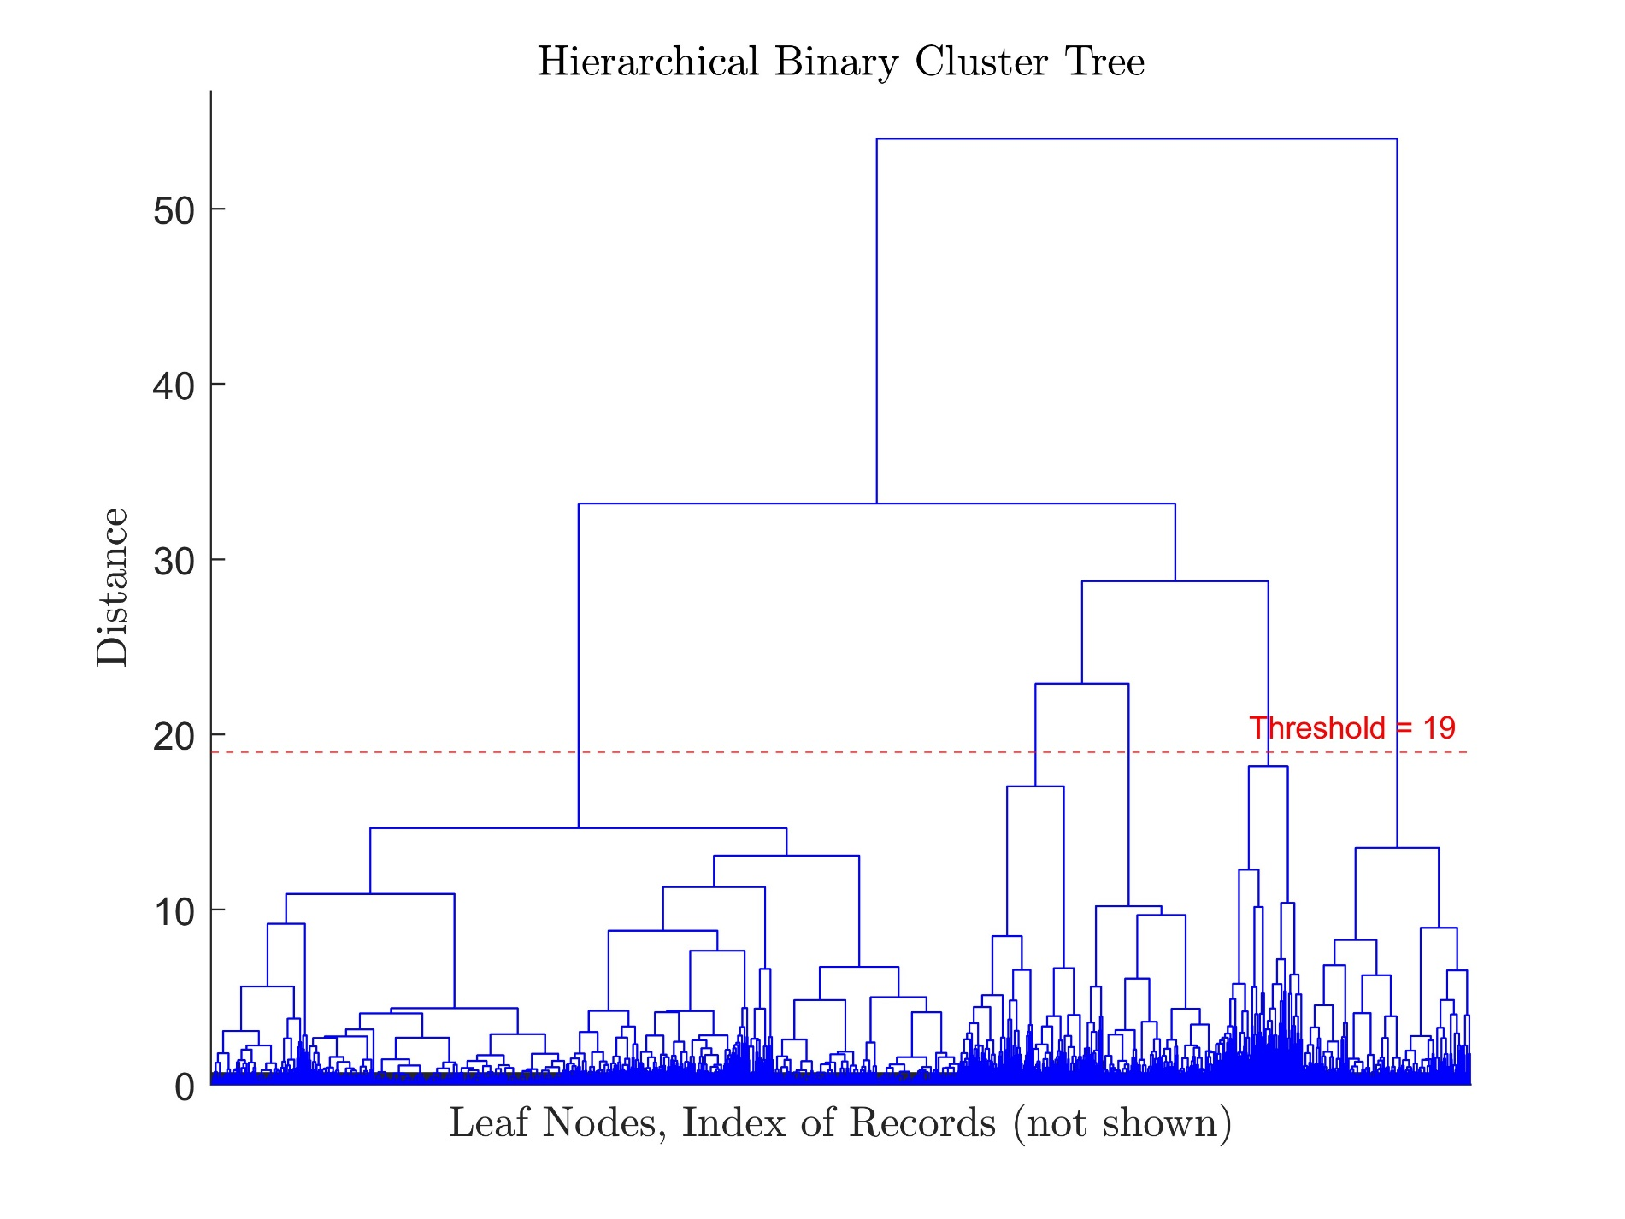
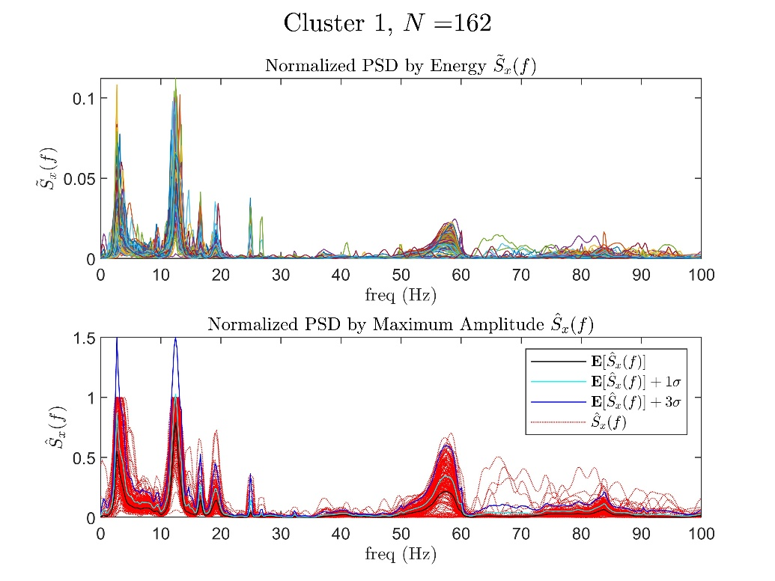
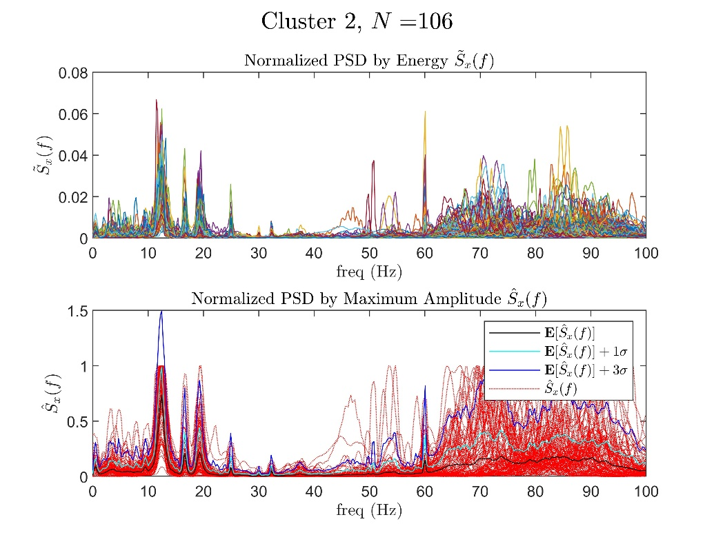
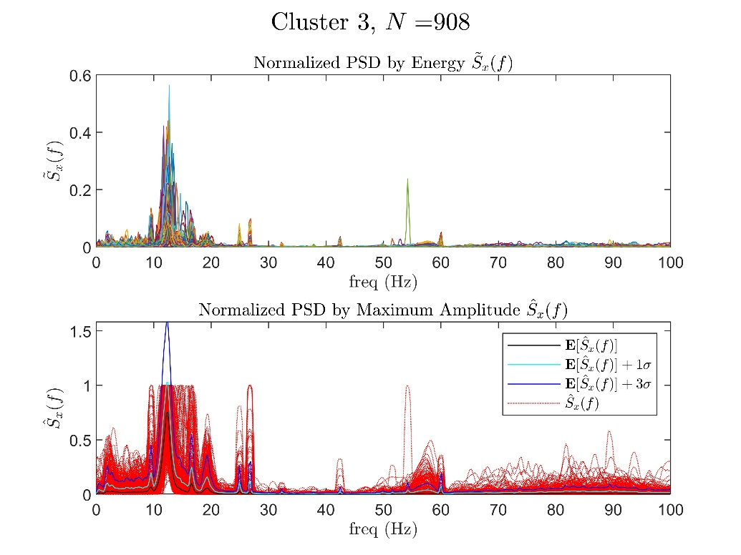
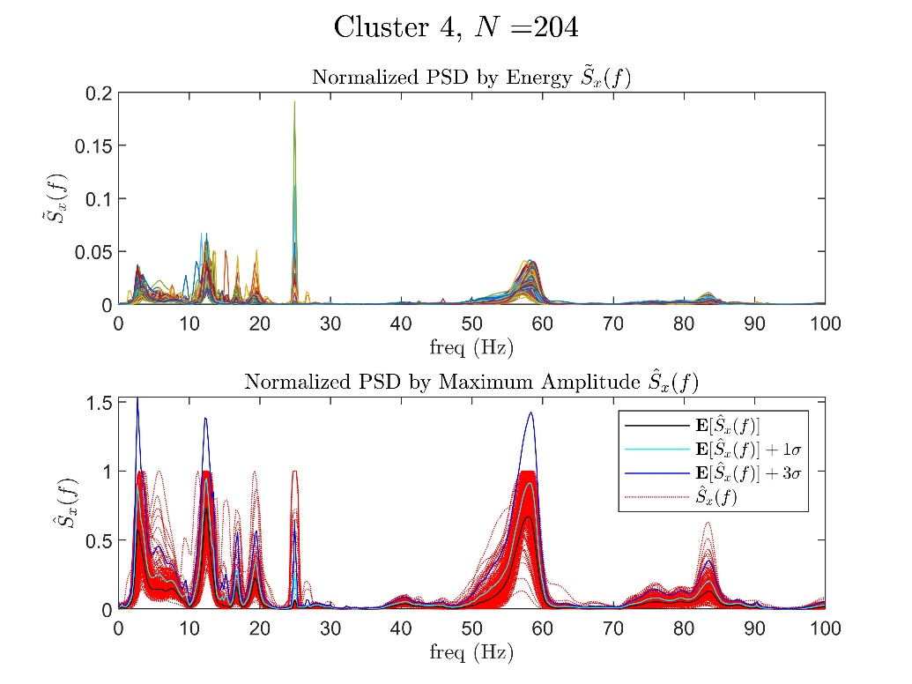
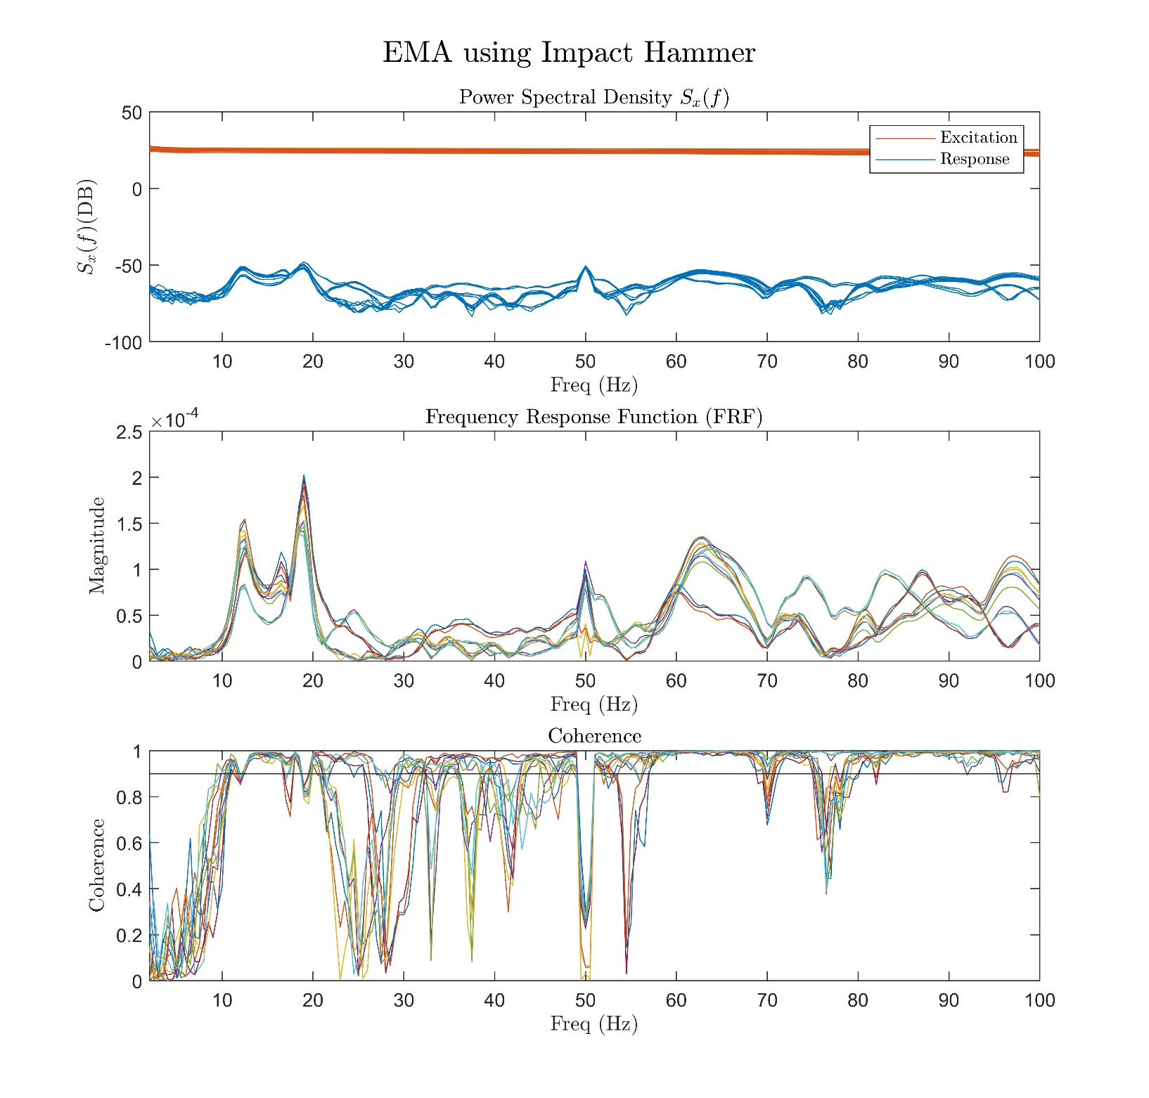
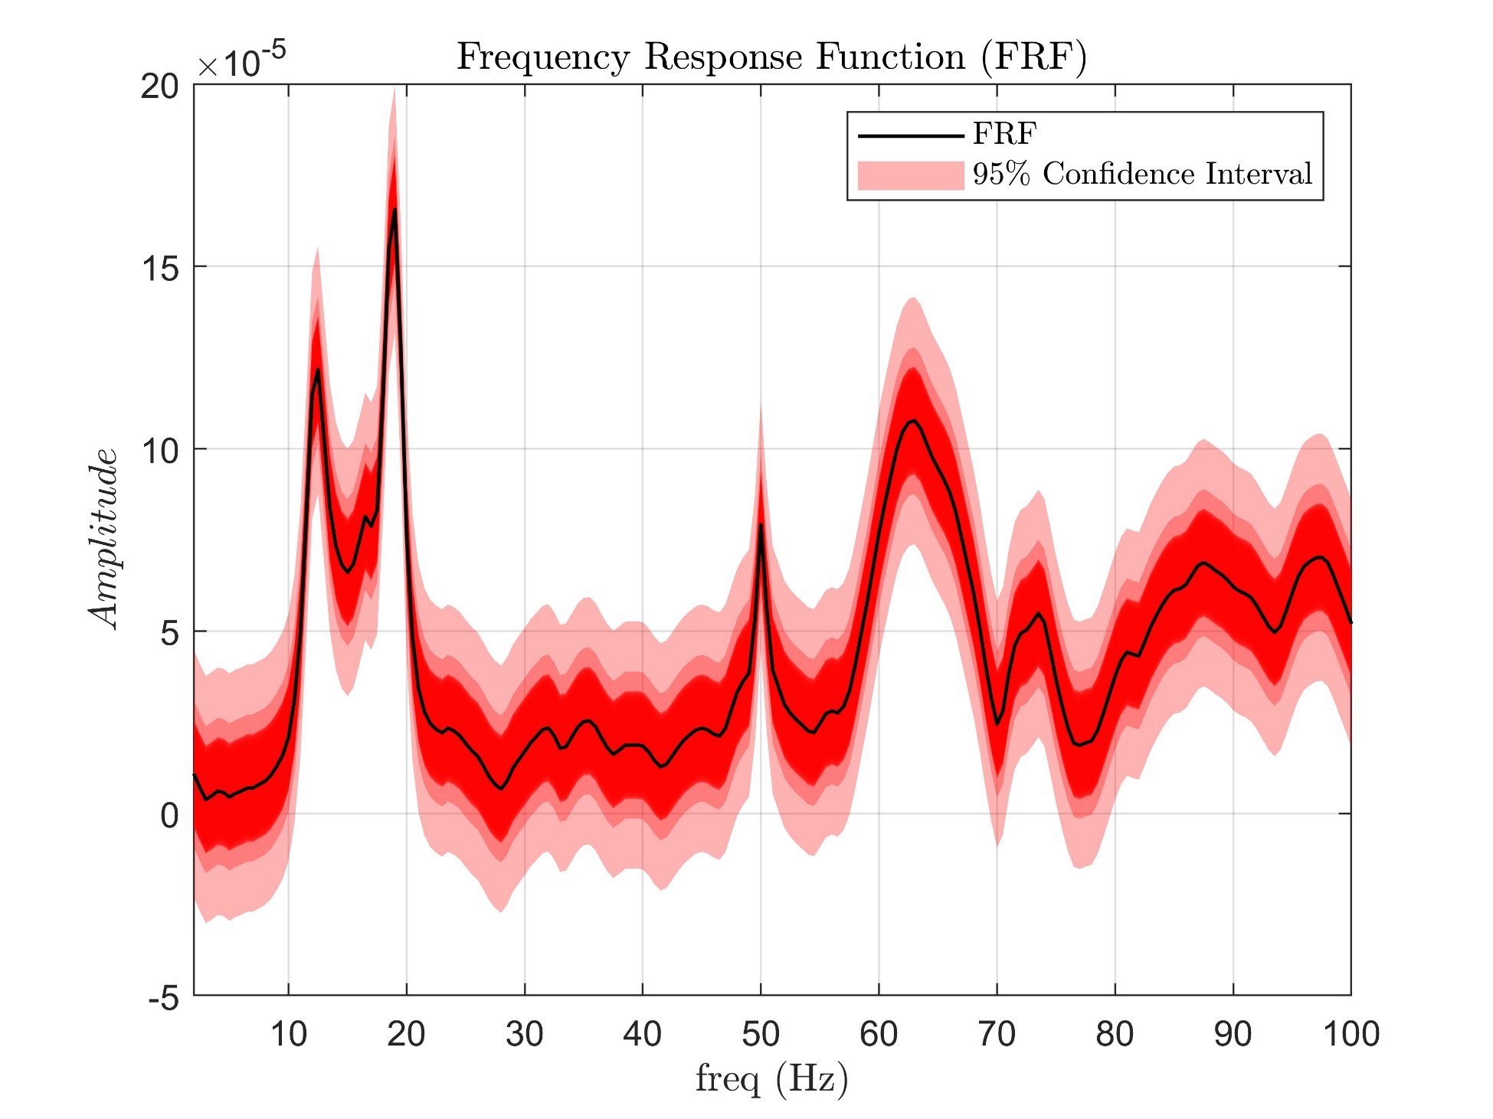
Research title
Wie-Teng, Kao
Prof. Dr. Gerhard Müller (Chair of Structural Mechanics), Prof. Dr. Wolfgang Wall (Chair of Numerical Mechanics)
Abstract
With increasing concerns about non-renewable resources, geothermal energy is becoming increasingly important for heat and power generation. Germany has set a goal to obtain a significant share of its energy from renewable sources by 2050. Deep geothermal plants are expected to make a significant contribution to meeting heat demand. However, these plants cause micro-seismic events that affect the serviceability of buildings and human comfort. Until now, the measurement of seismic activity in the Bavaria region relied on the free-field vibration sensor network. In a novel approach, additional sensors were recently installed on different levels of a low-rise building on the site of a geothermal plant in the south of Munich. This strategic sensor network aims to collect and analyze unique vibration data. The project focuses on improving the understanding and prediction of building responses to micro-earthquakes through data-driven model updating.
The first stage will involve processing and preparing existing sensor data using classical and modern machine learning approaches, such as unsupervised learning, for automatic data processing and feature extraction. The second stage will involve developing surrogate models to quantify uncertainty and replace detailed nonlinear analyses. These models will use experimental data to improve the prediction accuracy of structural behavior under induced seismicity. By improving existing building models using experimental data, this project aims to develop a prediction model to mitigate the effects of induced seismicity in geothermal plants. By monitoring building integrity under induced seismicity, the project will contribute to the safety and efficiency of geothermal operations in Munich and potentially worldwide.
Overall Framework
Overall Framework
To understand and predict the effect of micro-earthquake on buildings, the following framework is proposed (fig 1), which includes two stages. For this project, two databases are accessed; the first stores the sensor data from monitoring the vibration signals in the example building for over one year, and the second saves weak to moderated scaled geothermal-induced seismicity from seismic stations in the Insheim area, Germany.
Stage 1
In the first stages, The focus is on extracting the Frequency Response Functions (FRFs) or so-called Transfer Function (TF) and identifying the system of example building by analyzing the existing sensor data. The uncertainty of FRF will be quantified to better describe the building model. This process includes the following steps:
Clustering: Since the sensor data are unlabeled and the source of excitation is unknown, the clustering technique is utilized to characterize different response types based on their pattern of signals in the frequency domain. By analyzing each clustering, the outlier and the responses severely compromised by noise could be discarded priorly (fig 2).
Forming the FRFs: FRFs represent the response of a system per unit excitation as a function of frequency. The experimental FRFs of the building can be extracted by measurement tests, such as impact and shaker testing (fig 3). To parameterize the FRFs, the Rational Fraction Polynomial method (RFP) or the Mode Superposition Method (MSUP) could be applied, which are based on classical or modern curve fitting procedures.
Identify the system: The system of the building is commonly represented by the natural frequency, damping ratio, and the mode shapes of a structure. These parameters are significant for verifying accuracy and calibrating a finite element (FE) model. Practically, the building system can be identified using experimental modal analysis (EMA) or operational modal analysis (OMA). The difference between EMA and OMA is that EMA analyzes the system via measured force during the experiment, such as hammer impact and shaker. Conversely, OMA determines the system from operational vibration measurements, especially under real-world operational conditions.
Fig 2, The proposed framework of the whole project
Fig 1, The proposed framework of the whole project
Fig 3 The proposed framework of the whole project
Dr. Birte Maja Gerken
TUM Chair of Template Example
Address
Webpage
Email Address
M.Sc. Lorenz Gabel
TUM Chair of Template Example
Address
Webpage
Email Address
Dr. Marlene Backleh-Sohrt
TUM Chair of Template Example
Address
Webpage
Email Address
MDSI General Assembly, October 24, 2024

Slide 8
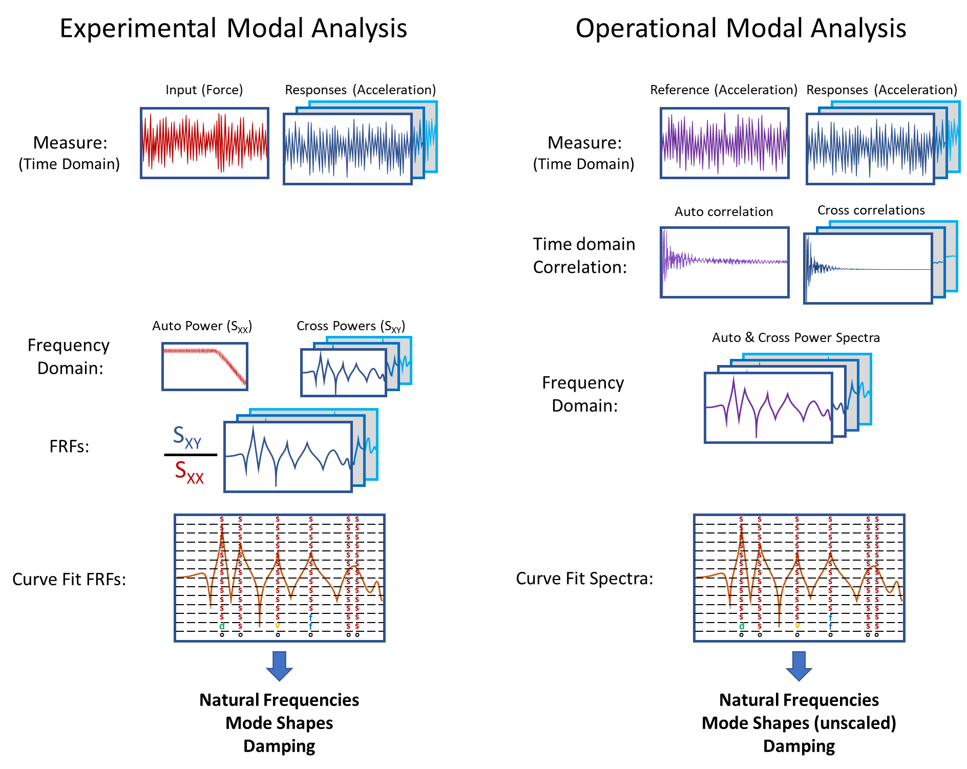
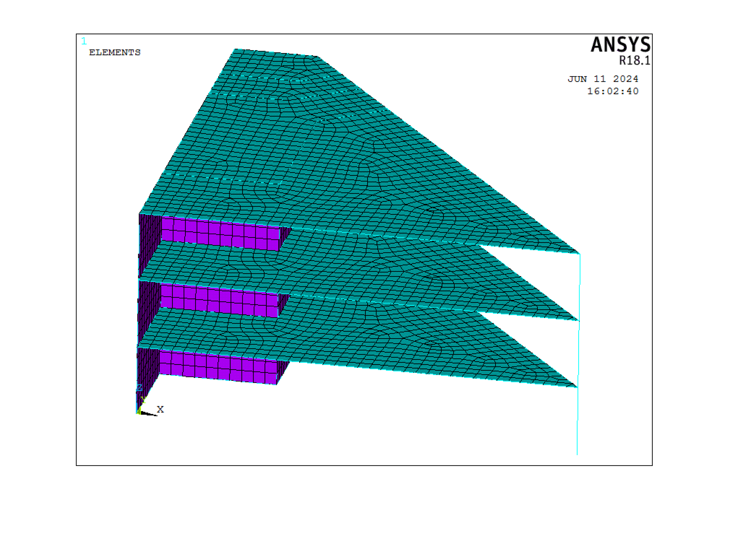
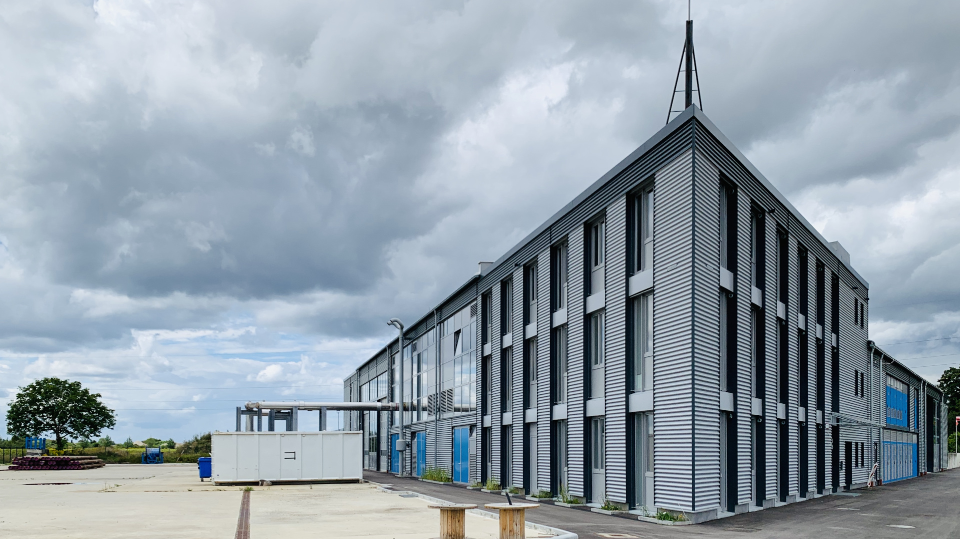

Research title
Wie-Teng, Kao
Prof. Dr. Gerhard Müller (Chair of Structural Mechanics), Prof. Dr. Wolfgang Wall (Chair of Numerical Mechanics)
Infer the possible excitations: Once the FRFs are formed and the predominant natural frequency and damping ratio are identified, the possible excitation causing the vibration of the building from the first database will be inferred. Combined with the information from clustering in the prior process, a better understanding of the environment and the properties of the example building, such as the effect of different excitation types on structures and the characteristics of response in various frequency ranges, can be obtained.
Stage 2
The surrogate model will be developed after preparing the system information from Stage 1. This surrogate model, including the ability to quantify the uncertainty, can efficiently interpret the relationship between structure responses and excitation. The following steps will accomplish this stage:
Building the FE model: The FE model transfers the real-world complex structure to the computational solvable model for the Finite Element Method (FEM). By defining the geometry of the building and the material properties of the structure, the mathematical building model will be built and ready for further analysis.
Updating the FE model: The result of FEM is commonly deterministic and depends on the parameters defined by the user. This implies that if the user provides inappropriate parameters for the model, then the following simulation might lead to an inaccurate result. To overcome this issue and improve the accuracy of the result, the parameters of the FE model are updated and validated by the system information identified in the first stage. This process is crucial to generate a representative FE model for precise results from simulation.
Simulation: To understand the influence of geothermal-induced earthquakes on the example building, the structure dynamic response is simulated by Transient or Harmonic analysis using the commercial software ANSYS. The maximum velocity of the building under excitation provided by the second database will be analyzed in this step.
Building the surrogate model: Simulation via FEM is time-consuming and computationally expensive. Some high-fidelity time-dependent simulations might take over 8 hours for only one event. To fulfill the goals of this project, which might require evaluating more than 1000 events, the techniques to accelerate or replace the costly simulation are necessary. Building a probability-based surrogate model helps us efficiently re-construct the relationship between input parameters and output results and considers the uncertainty. This surrogate model can be built using advanced regression methods or machine learning techniques, such as Neural Networks (NN).
Fig 3 The proposed framework of the whole project
Fig 3 The proposed framework of the whole project
Dr. Birte Maja Gerken
TUM Chair of Template Example
Address
Webpage
Email Address
M.Sc. Lorenz Gabel
TUM Chair of Template Example
Address
Webpage
Email Address
Dr. Marlene Backleh-Sohrt
TUM Chair of Template Example
Address
Webpage
Email Address
MDSI General Assembly, October 24, 2024

Slide 9
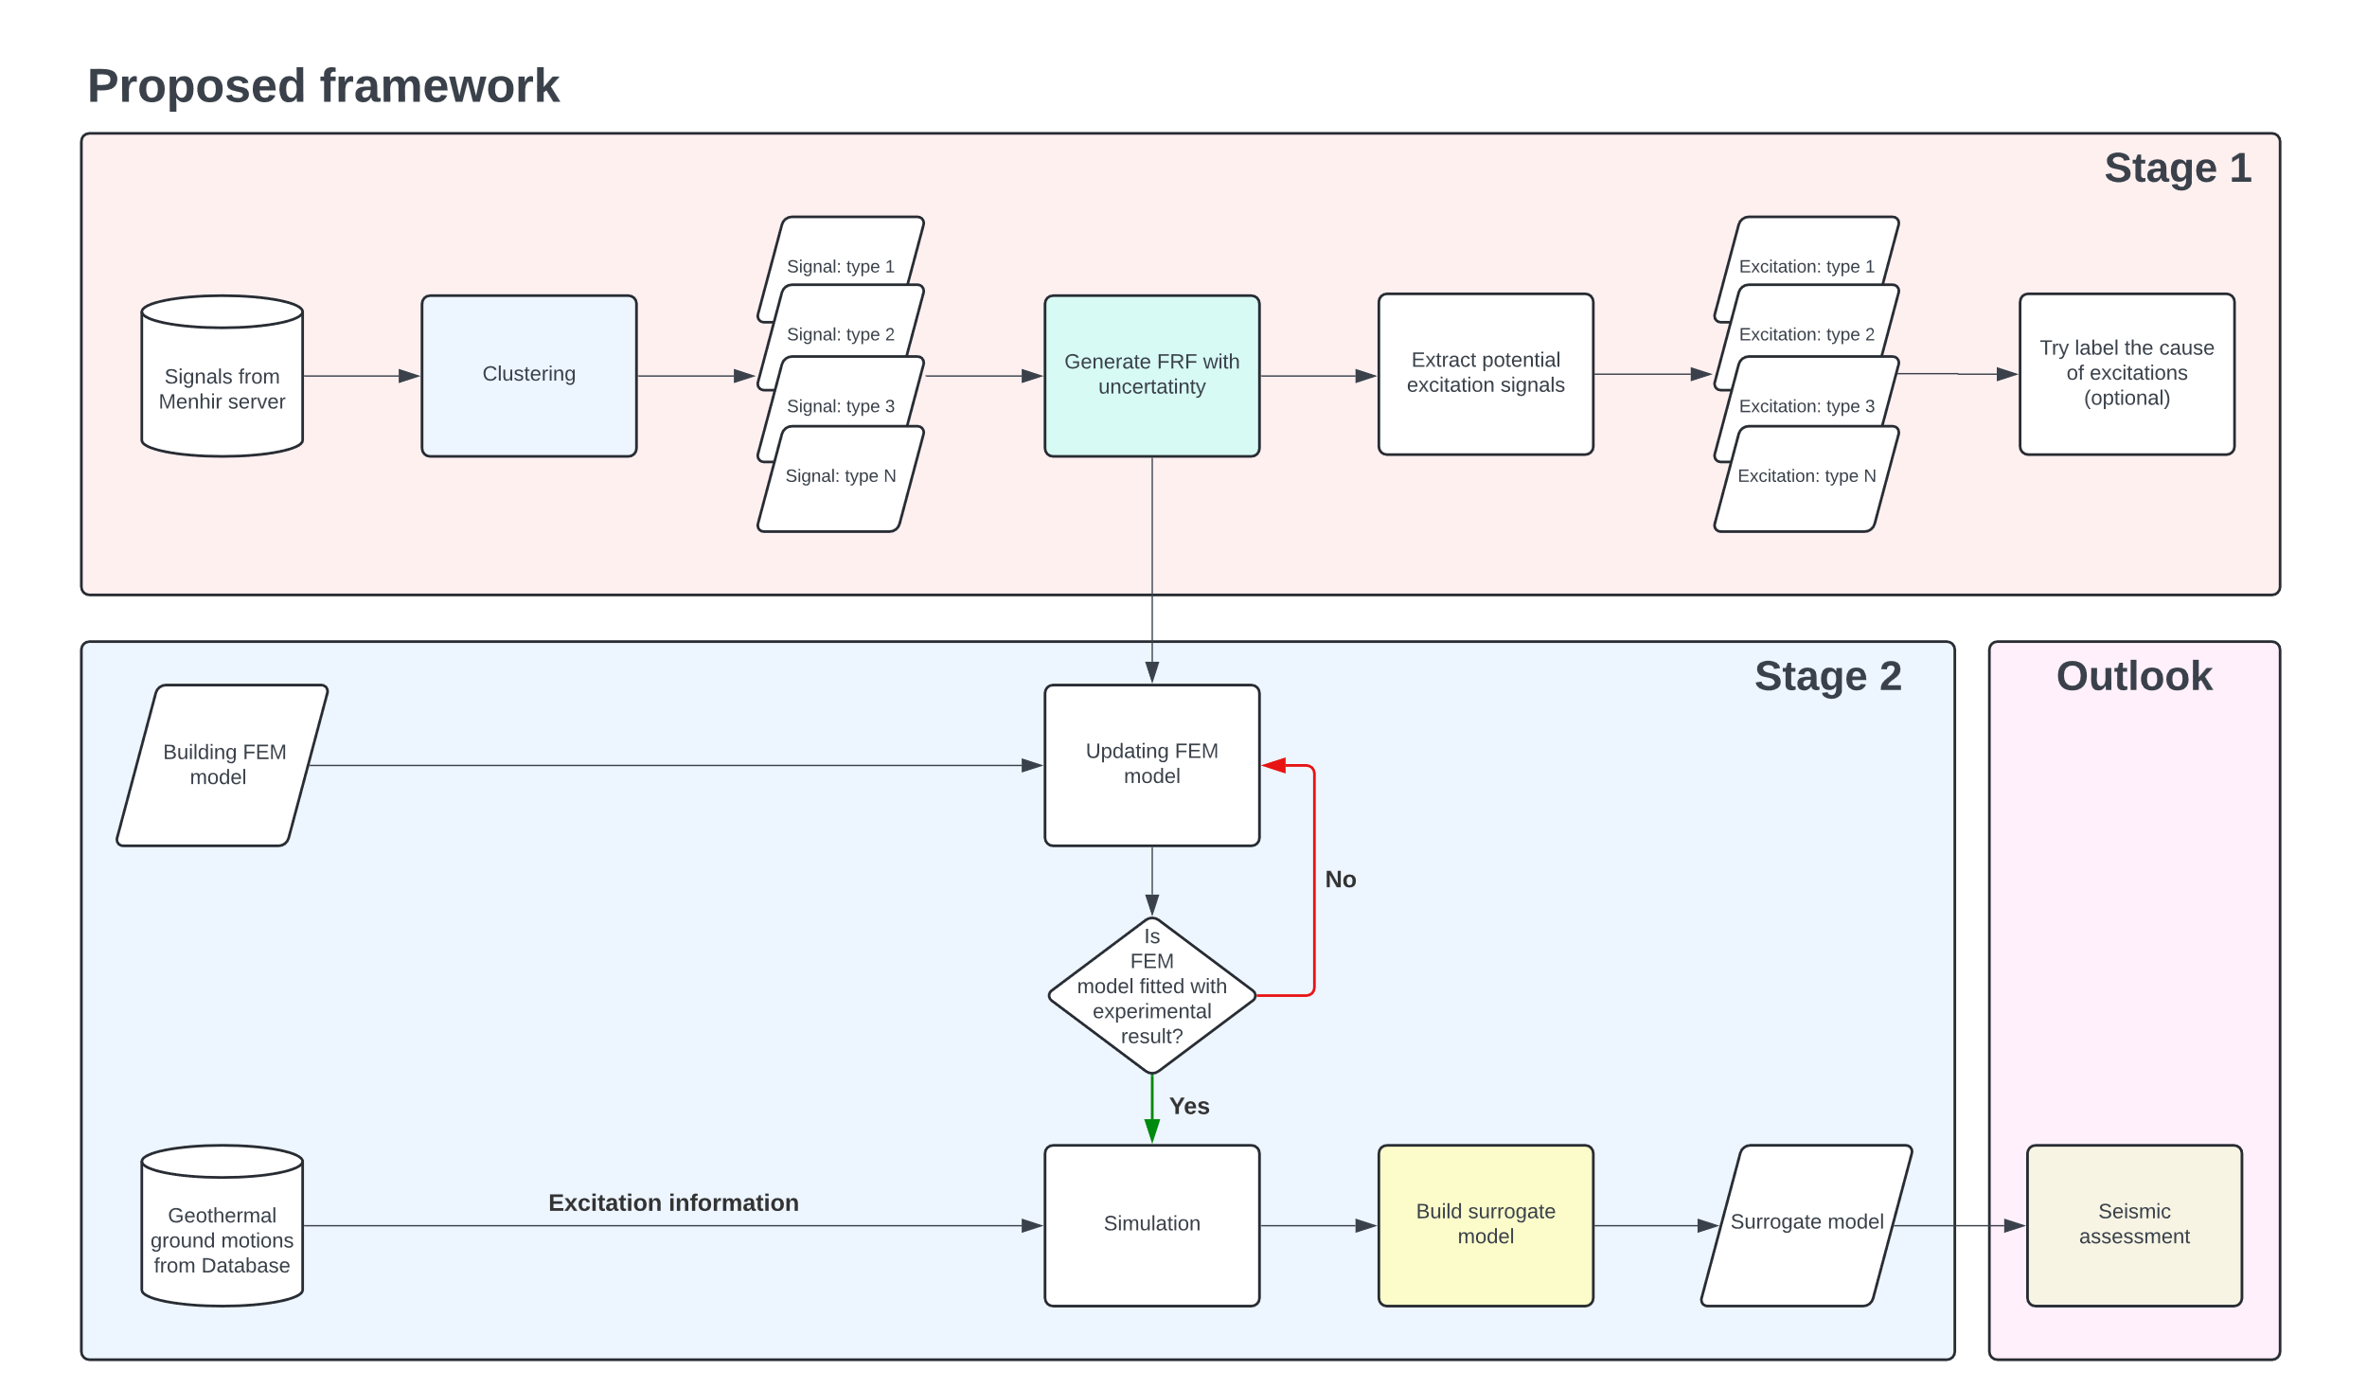
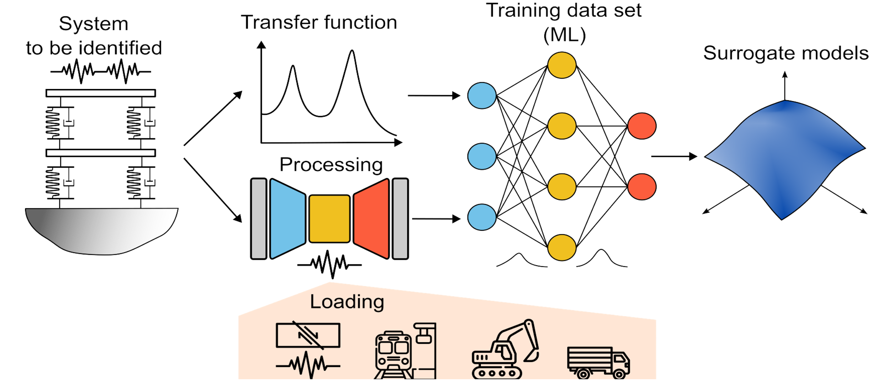

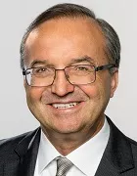
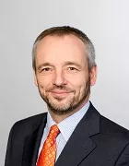
Enhancing Seismic Safety in Munich's Geothermal Energy Sector: Data-driven Model Updating for Building Vibrations under Induced Seismicity
Wie-Teng, Kao
Prof. Dr. Gerhard Müller (Chair of Structural Mechanics), Prof. Dr. Wolfgang Wall (Chair of Numerical Mechanics)
Abstract
With increasing concerns about non-renewable resources, geothermal energy is becoming increasingly important for heat and power generation. Germany has set a goal to obtain a significant share of its energy from renewable sources by 2050. Deep geothermal plants are expected to make a significant contribution to meeting heat demand. However, these plants cause micro-seismic events that affect the serviceability of buildings and human comfort [1]. Until now, the measurement of seismic activity in the Bavaria region relied on the free-field vibration sensor network. In a novel approach, additional sensors were recently installed on different levels of a low-rise building on the site of a geothermal plant in the south of Munich. This strategic sensor network aims to collect and analyze unique vibration data. The project focuses on improving the understanding and prediction of building responses to micro-earthquakes through data-driven model updating.
The first stage will involve processing and preparing existing sensor data using classical and modern machine learning approaches, such as unsupervised learning, for automatic data processing and feature extraction. The second stage will involve developing surrogate models to quantify uncertainty and replace detailed nonlinear analyses. These models will use experimental data to improve the prediction accuracy of structural behavior under induced seismicity. By improving existing building models using experimental data, this project aims to develop a prediction model to mitigate the effects of induced seismicity in geothermal plants. By monitoring building integrity under induced seismicity, the project will contribute to the safety and efficiency of geothermal operations in Munich and potentially worldwide (fig 1).
Overall Framework
To understand and predict the effect of micro-earthquake on buildings, the following framework is proposed (fig 2), which includes two stages. For this project, two databases are accessed; the first stores the sensor data from monitoring the vibration signals in the example building for over one year, and the second saves weak to moderated scaled geothermal-induced seismicity from seismic stations in the Insheim area, Germany.
Stage 1
In the first stages, The focus is on extracting the Frequency Response Functions (FRFs) or so-called Transfer Function (TF) and identifying the system of example building by analyzing the existing sensor data. The uncertainty of FRF will be quantified to better describe the building model. This process includes the following steps:
Clustering: Since the sensor data are unlabeled and the source of excitation is unknown, the clustering technique is utilized to characterize different response types based on their pattern of signals in the frequency domain. By analyzing each clustering, the outlier and the responses severely compromised by noise could be discarded priorly (fig 3).
Identify the system: The system of the building is commonly represented by the natural frequency, damping ratio, and the mode shapes of a structure. These parameters are significant for verifying accuracy and calibrating a finite element (FE) model. Practically, the building system can be identified using experimental modal analysis (EMA) or operational modal analysis (OMA) [2]. The difference between EMA and OMA is that EMA analyzes the system via measured force during the experiment, such as hammer impact and shaker. Conversely, OMA determines the system from operational vibration measurements, especially under real-world operational conditions (fig 4).
Forming the FRFs: FRFs represent the response of a system per unit excitation as a function of frequency. The experimental FRFs of the building can be extracted by measurement tests, such as impact and shaker testing (fig 5). To parameterize the FRFs, the Rational Fraction Polynomial method (RFP) or the Mode Superposition Method (MSUP) could be applied, which are based on classical or modern curve fitting procedures.
Fig 3, Clustering the recorded sensor data using the Hierarchical Clustering technique .
Fig 2, The proposed framework of the whole project
Fig 1, Schematic diagram of the project. By monitoring the vibration of the example building, the system of the building and the potential loading types can be identified. The behavior of such structure dynamics will be trained and predicted by the surrogate model built via the machine learning technique.
Fig 4, Comparison of two system identification techniques, EMA and OMA
(https://community.sw.siemens.com/s/article/OMG-What-is-OMA-Operating-Modal-Analysis) .
M.Sc. Wei-Teng Kao
TUM Chair of Structural Mechanic
Technical University of Munich Arcisstr. 21 80333 Munich
ge32gak@mytum.de
Prof. Dr. Gerhard Müller
TUM Chair of Structural Mechanic
Technical University of Munich Arcisstr. 21 80333 Munich
gerhard.mueller@tum.de
Prof. Dr. Wolfgang Wall
TUM of Numerical Mechanics
Technical University of Munich
Boltzmannstr. 15 85748 Garching b.
wolfgang.a.wall@tum.de
MDSI General Assembly, October 24, 2024

Slide 10
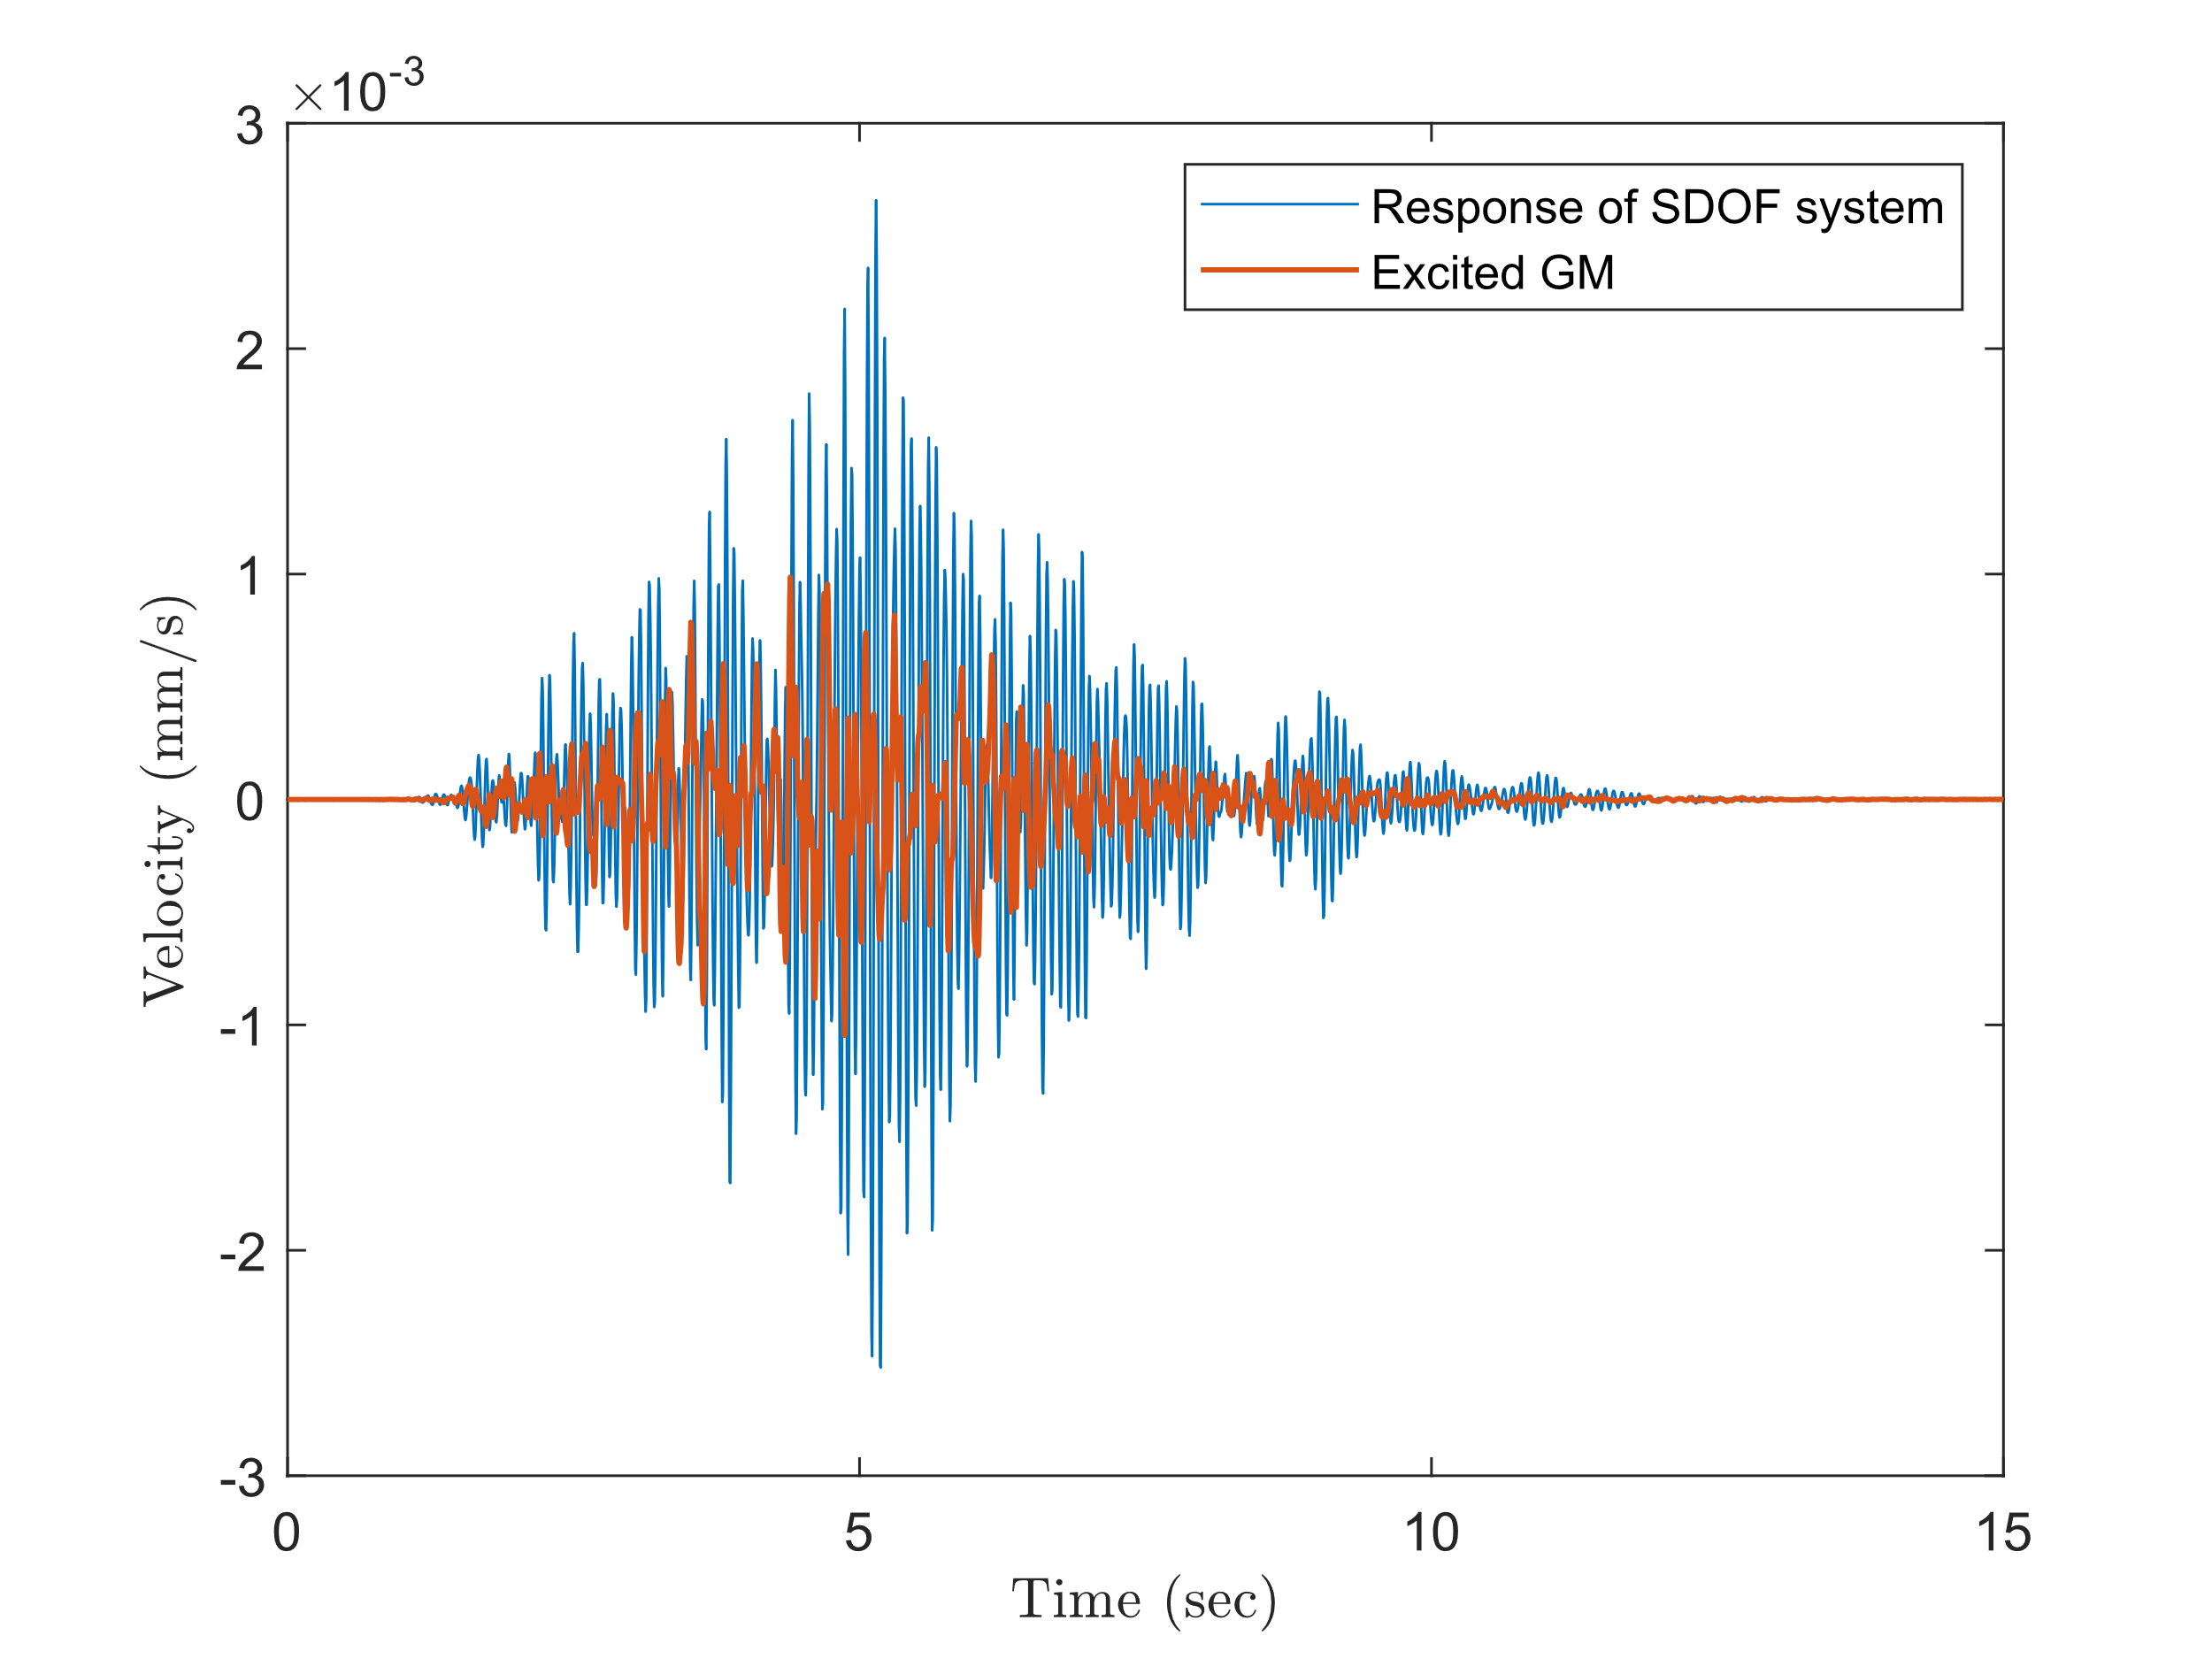
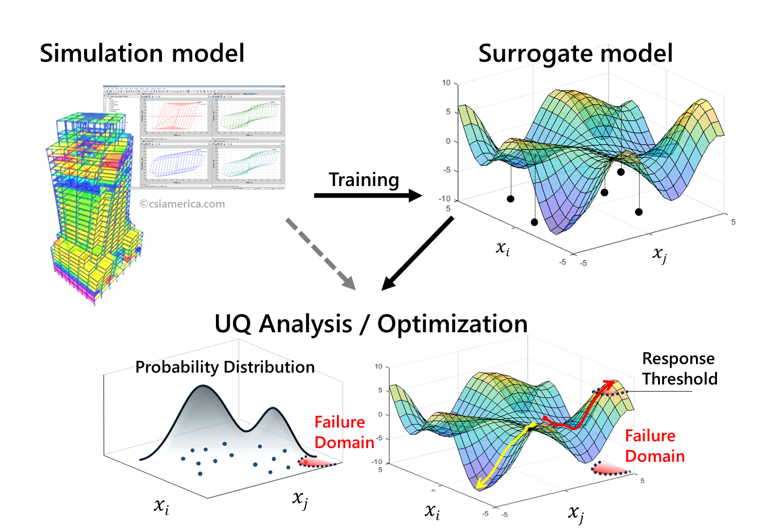
Enhancing Seismic Safety in Munich's Geothermal Energy Sector: Data-driven Model Updating for Building Vibrations under Induced Seismicity
Wie-Teng, Kao
Prof. Dr. Gerhard Müller (Chair of Structural Mechanics), Prof. Dr. Wolfgang Wall (Chair of Numerical Mechanics)
Infer the possible excitations: Once the FRFs are formed and the predominant natural frequency and damping ratio are identified, the possible excitation causing the vibration of the building from the first database will be inferred. Combined with the information from clustering in the prior process, a better understanding of the environment and the properties of the example building, such as the effect of different excitation types on structures and the characteristics of response in various frequency ranges, can be obtained.
Stage 2
The surrogate model is a model that can efficiently interpret the relationship between input and output behavior of complex systems. The surrogate model will be developed after the training data from Stage 1 are prepared. The following steps will accomplish this stage:
Building the FE model: The FE model transfers the real-world complex structure to the computational solvable model for the Finite Element Method (FEM). By defining the geometry of the building and the material properties of the structure, the mathematical building model (fig 6) will be built and ready for further analysis.
Updating the FE model: The result of FEM is commonly deterministic and depends on the parameters defined by the user. This implies that if the user provides inappropriate parameters for the model, then the following simulation might lead to an inaccurate result. To overcome this issue and improve the accuracy of the result, the parameters of the FE model are updated and validated by the system information identified in the first stage. This process is crucial to generate a representative FE model for precise results from simulation.
Simulation: To understand the influence of geothermal-induced earthquakes on the example building, the structure dynamic is simulated by Transient or Harmonic analysis using the commercial software ANSYS. The input loadings focused on by this project are the vibration signals of geothermal-induced earthquakes recorded from seismic stations. The result provides information on the building’s deformation, velocity, or any requested physical information under such excitation (fig 6).
Building the surrogate model: Simulation via FEM is time-consuming and computationally expensive. Some high-fidelity time-dependent simulations might take over 8 hours for only one event. To fulfill the goals of this project, which might require evaluating more than 1000 events, the techniques to accelerate or replace the costly simulation are necessary. Building a probability-based surrogate model helps us efficiently re-construct the relationship between input parameters and output results and considers the uncertainty (fig 7). This surrogate model can be built using advanced regression methods or machine learning techniques, such as Neural Networks (NN).
Outlook
This seed-fund project aims to construct an efficient model to represent the example building by combining existing sensor data, computational mechanics, and modern machine-learning techniques. This model could be used for further analysis, such as:
Global sensitivity analysis (GSA): The GSA provides information about the significance of each designed parameter. With this technique, researchers can better understand which parameter of the building might have caused the largest impact on the structure under earthquakes.
Serviceability analysis: This assessment analyzes a structure’s ability to remain functional and comfortable for its occupants during normal usage without exceeding certain limits on factors like deflection, vibration, and cracking.
Comfortability analysis: Comfortability analysis for buildings evaluated the influence of the comfort and well-being of the occupants within the built environment.
Reference
FE Model
https://www.tiefegeothermie.de/news/ertuechtigung-der-geothermiebohrungen-taufkirchen
Simulation
Fig 6, Building the FE model and perform the simulation to understand the structure dynamics of the example building under excitation [3].
Fig 5, FRFs obtained by hammer testing using EMA technique, N = 13 (left), and the mean FRF with the 95% confidence range (right)
Fig 7, Schematic diagram of building surrogate model. With the help of the surrogate model, the researcher can compute the representative result for the problem without time-consumed simulation and accelerate the process of further risk assessment [4] .
[1] Küperkoch, L ; Olbert, K ; Meier, T: Long-term monitoring of induced seismicity at the Insheim geothermal site, Germany. In: Bulletin of the Seismological Society of America 108 (2018), Nr. 6, p. 3668–3683.
[2] Orlowitz, E., & Brandt, A. (2017). Comparison of experimental and operational modal analysis on a laboratory test plate. Measurement, 102, 121-130.
[3] Kao, W.T. (2024). Integrated Parameter Study and Serviceability Assessment of Building Structures under Geothermally Induced Seismicity using Stochastic Polynomial Chaos Expansion [Unpublished master's thesis]. Technical University of Munich.
[4] Zou, J., Welch, D. P., Zsarnoczay, A., Taflanidis, A., & Deierlein, G. G. (2020). Surrogate Modeling for the Seismic Response Estimation of Residential Wood Frame Structures.
M.Sc. Wei-Teng Kao
TUM Chair of Structural Mechanic
Technical University of Munich Arcisstr. 21 80333 Munich
ge32gak@mytum.de
Prof. Dr. Gerhard Müller
TUM Chair of Structural Mechanic
Technical University of Munich Arcisstr. 21 80333 Munich
gerhard.mueller@tum.de
Prof. Dr. Wolfgang Wall
TUM of Numerical Mechanics
Technical University of Munich
Boltzmannstr. 15 85748 Garching b.
wolfgang.a.wall@tum.de
MDSI General Assembly, October 24, 2024

